Slide 1
Games Bootcamp Conceptualisation
Game Conceptualisation & Design

Slide 2
Table of contents
01
Recap
04
Unity
02
Conceptualisation
03
Game Genres
Game Dev Fundamentals
Setup & Install
Player experience & design considerations
Which to choose.

Slide 3
01
Recap
5 Game Design Elements
6 Game Development Stages

Slide 4
02
Conceptualisation
Player Experience & Design Considerations

Slide 5

Where to Start
How do you come up with a great game?
Start with a great prototype!
Iterate.
Experiment.

Slide 6
Considerations
Genre
Audience
Platform
Theme
Art Style
Level Design
What is the genre of the game?
Who is the game for?
Mobile, PC, Console
What is the world of your game?
What assets will you need?
How will levels be structure?

Slide 7
Considerations
Accessibility
Feasibility
Scope
Monetization
Feedback
Marketing
More important than ever!
Do you have the resources for this?
Define it and stick to it!
How are we making money?
How will you promote the game?
How will you gather and incorporate feedback?

Slide 8
03
Game Genres

Slide 9
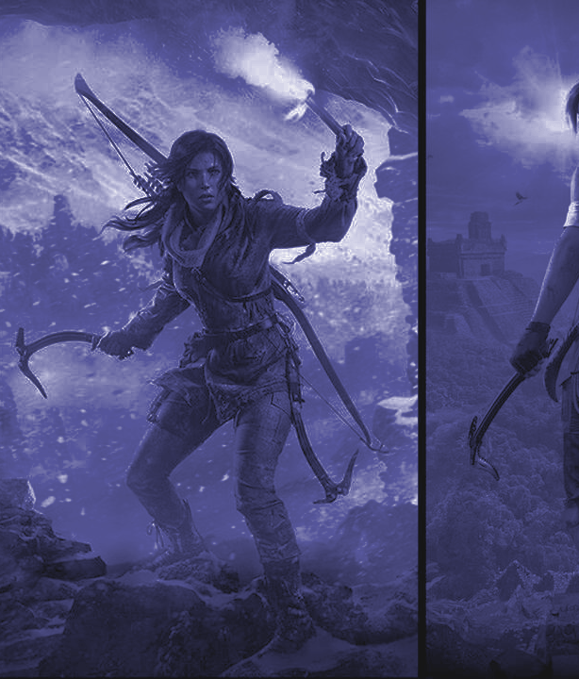
Action/Adventure
Combines combat, exploration and problem solving
Focus on thrill and action sequences
Less strategy involved

Slide 10
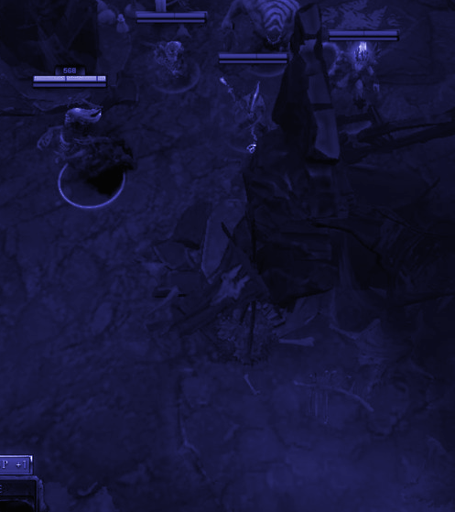
Role-Playing Games (RPG)
Character development and world building
Exploration, Quests and Turn-Based Combat
Focus on Dialogue and story
Slower Pace Experience.

Slide 11
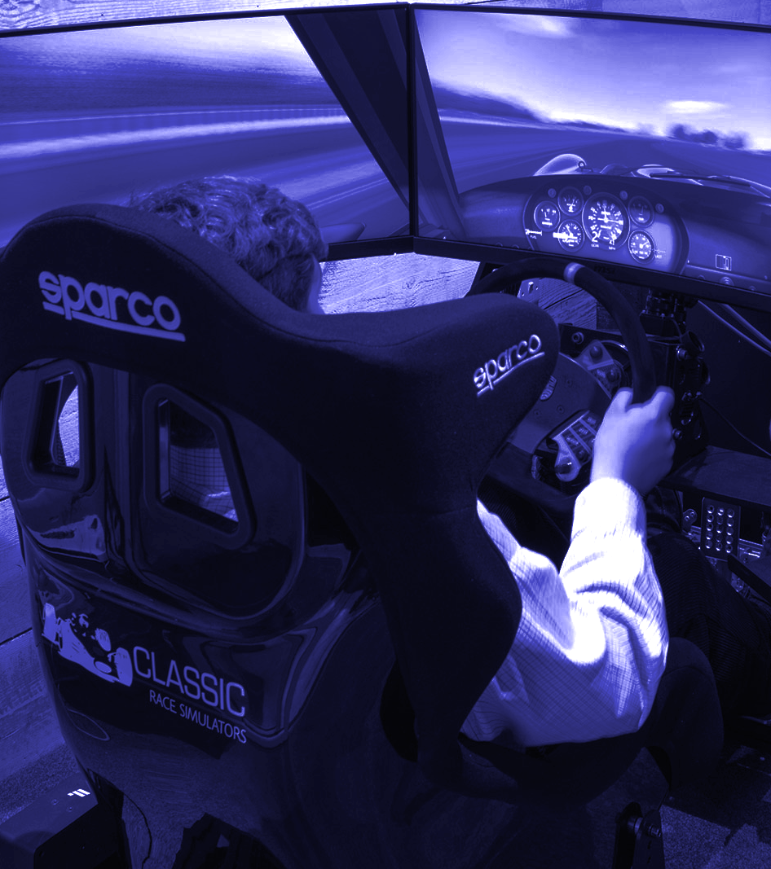
Simulation
Replicates real-world activities
Caters to niche markets
Lacks creative freedom.

Slide 12
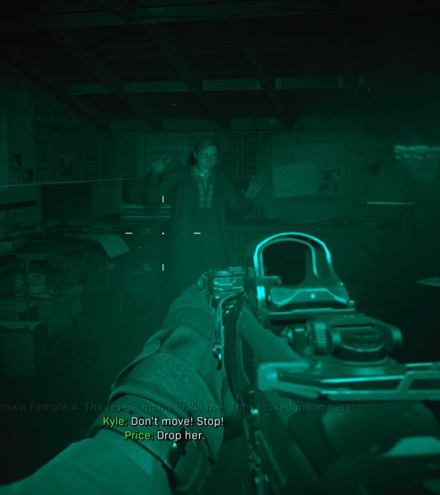
First-Person Shooter (FPS)
Camera in-front of Player Character (PC)
Emphasis on tactics and aiming
Great for competitive multiplayer
Skill requirements are high

Slide 13
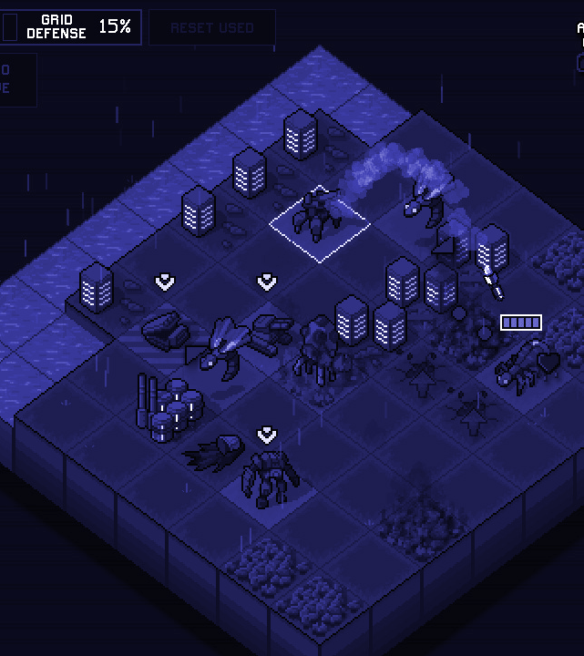
Top-Down
Camera overhead usually orthographic.
Often used in strategy games
Visual of large portion of map
Limits immersion

Slide 14
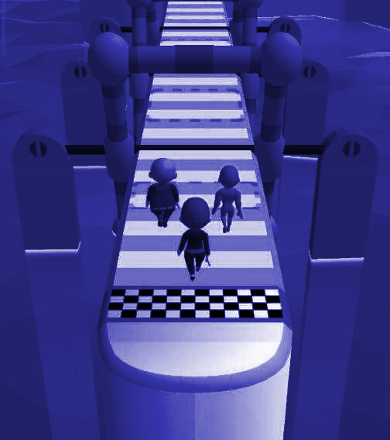
Hyper-Casual
Simplistic mechanics.
Can be played with one hand or a few swipes/taps
Short Play Sessions

Slide 15
Hyper-Casual
Sub-Genres
Puzzle
Tap/Timing
Swipes/Destruction
Endless Runner

Slide 16
04
Unity
Setting up a new project.

Slide 17
GDD

Slide 18
Considerations
Genre
Audience
Platform
Theme
Art Style
Level Design
What is the genre of the game?
Who is the game for?
Mobile, PC, Console
What is the world of your game?
What assets will you need?
How will levels be structure?

Slide 19
Considerations
Accessibility
Feasibility
Scope
Monetization
Feedback
Marketing
More important than ever!
Do you have the resources for this?
Define it and stick to it!
How are we making money?
How will you promote the game?
How will you gather and incorporate feedback?

